Slide 1
Golden Gate Community
Gold Key Engineering:
Amelia Foulkes, Hannah Lee, Kevin Long, Carter Schmidt, Felipe Solera, Echo Zhu
Notes:
Hi, we’re gold key engineering and we’ll be presenting our neighborhood design for the golden gate community.

Slide 2
Overview
Project Location
Issue
Buildings
Electricity
Water
Transportation
Urban Metabolism and Greenhouse Gas Estimations
Conclusions
Notes:
Hannah
So, in this presentation we will go over the project location, the issue we plan to focus on, the buildings, electricity, water, and transportation systems, the greenhouse gas emissions for these systems, and then our final conclusions.

Slide 3
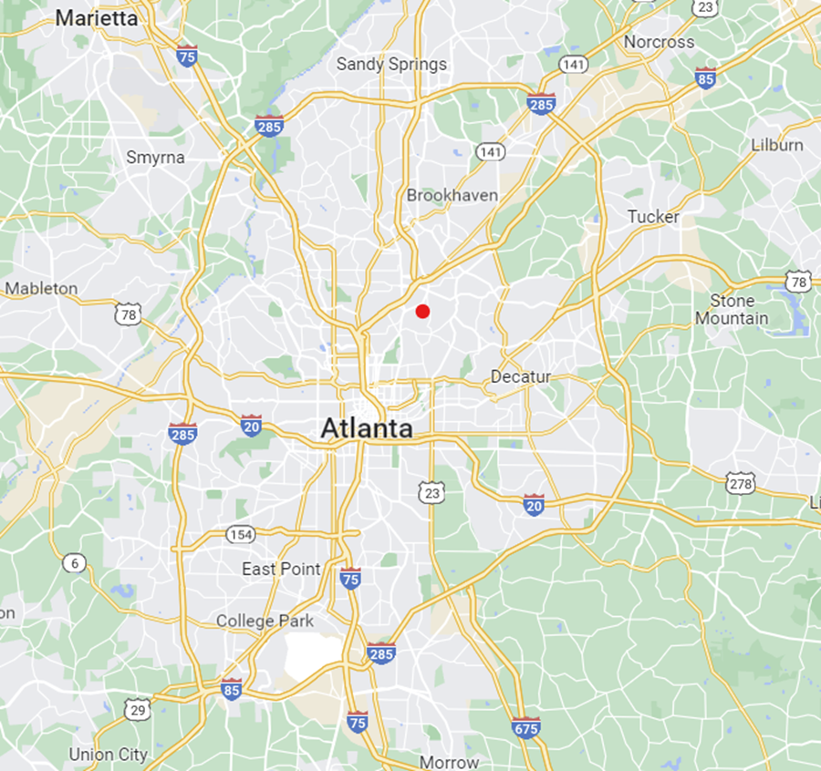


Project Location (1)
In the Greater Atlanta Area
Project Location
N
Notes:
Hannah
Our project is located within the greater atlanta area where the red dot is shown on the map here.

Slide 4
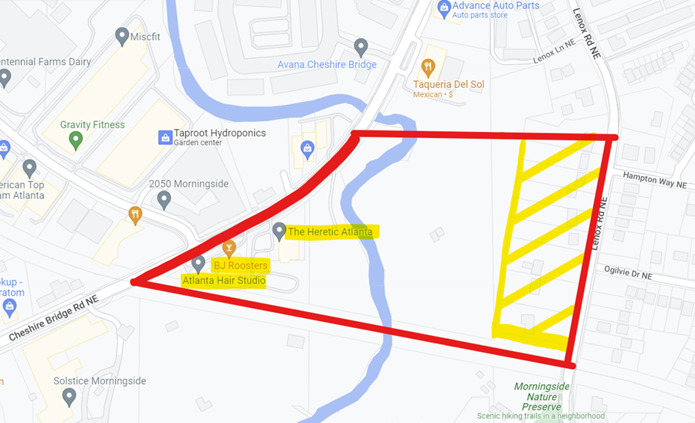
Project Location (2)
South Fork Peachtree Creek
Cheshire Bridge Rd NE
0.1 km²
Lenox Rd NE
N
CSX Transportation Line
Notes:
The project area is bound by the cheshire bridge road on the west side, the CSX transportation line on the south, the lenox road on the east, and a roughly linear line across for the northern boundary for a total of about 0.1 kilometers squared.
Within our project area there is a creek that flows through the center, and there are 3 existing structures in the SW corner and a residential area on east side.

Slide 5
Issue
Objective: improve accessibility and quality of life for the aging
Special Concerns:
Physical Health
  Disabilities
  Mobility issues
Mental Health
  Neurological disorders (i.e. depression, dementia, anxiety disorders)
  Loneliness
  Many have experienced loss
Notes:
Hannah
So our objective is to improve accessibility and quality of life for the aging through the design of our community.
The older population often struggles with both physical and mental health concerns such as a mobility issues and neurological disorders.

Slide 6
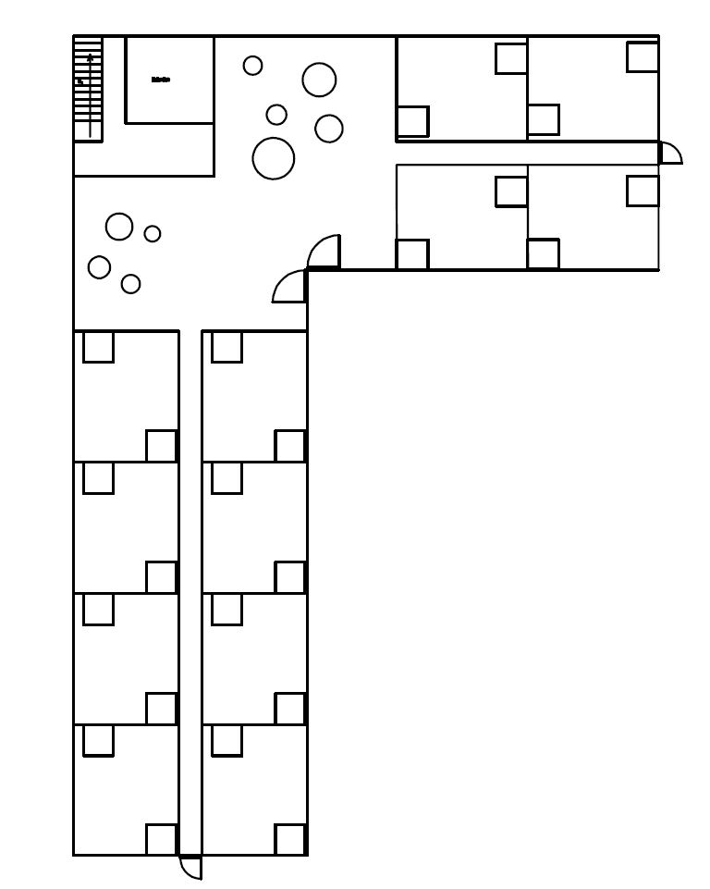
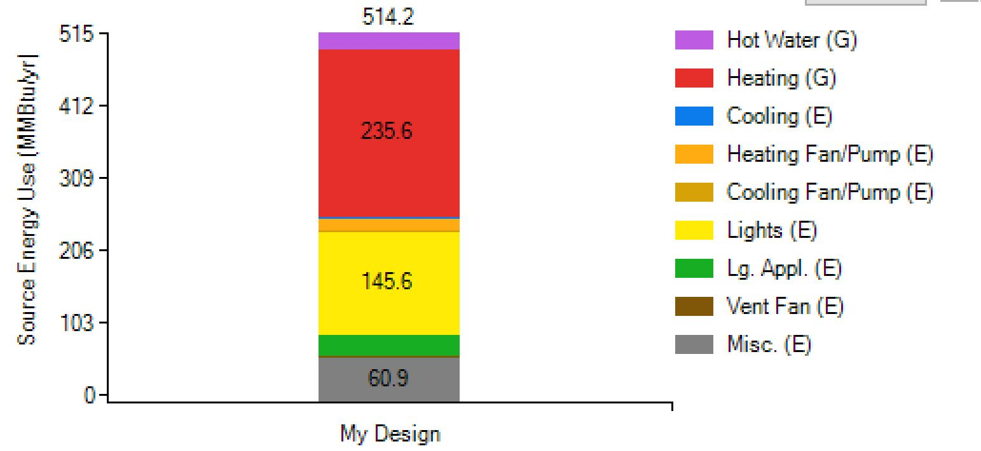
Buildings (1)
Residential buildings
10 6-floor buildings
Lower floors for more vulnerable individuals
Familiarity and comfort
Sustainability: triple-paned low emissivity windows, insulated building envelope, shade, ventilation and efficient energy systems, LEED Certification
Energy use
24.8 MWh per day
Residential
Layout
BEopt
Software
Notes:
Felipe

Slide 7
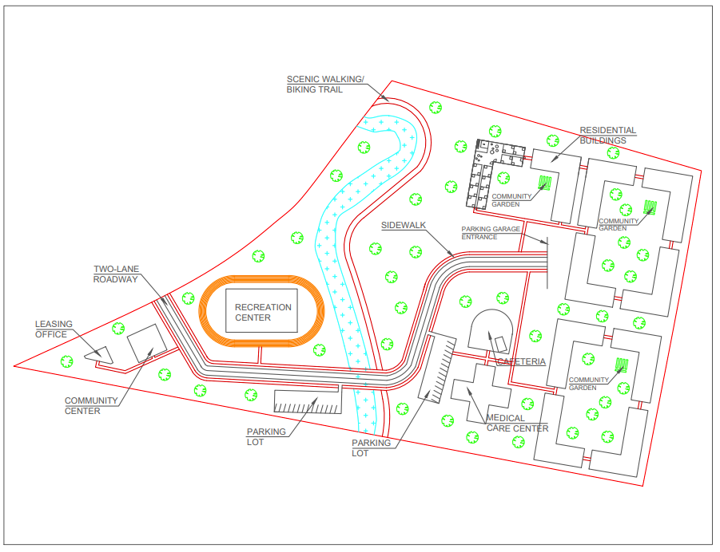
Buildings (2)
Site Plan
Building types
Recreational center
Leasing office
Community center
Medical center
Cafeteria
Residential
Notes:
Felipe
Scenic trail along creek
Two lane roadway
Parking lots
Underground parking garage
7 foot sidewalks - accessible
Community gardens - greywater systems

Slide 8
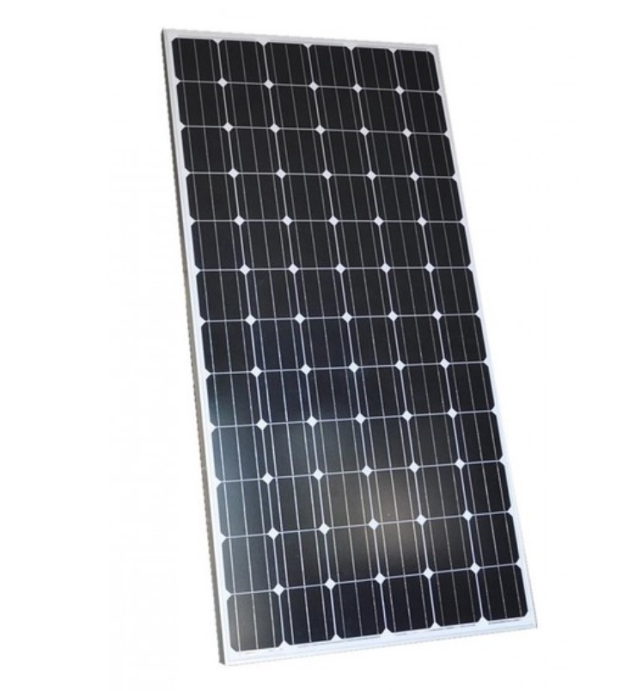
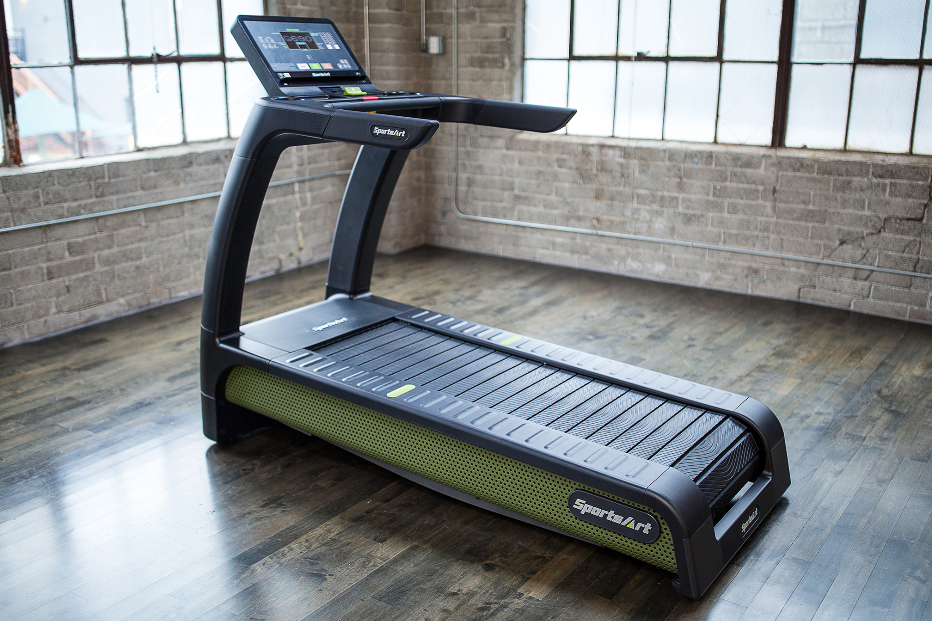
Electricity
Power generation station
  Georgia Power
  Emory Trolley Line Substation
  Transmission lines, power lines
Energy efficient appliances
Energy conservation classes
Solar Power
  5000 72-cell panel, 375 watts
  Fixed tilt latitude of 33.65 degrees - 5.1 hours direct sunlight
  Reduction of 3.83 t CO2e
Kinetic Generation
  Kinetic energy gym equipments
  Powers ⅕ of the recreational center
Notes:
Main form of electric usage will be provide by georgia powers
In order to reduce carbon emmisions

Slide 9
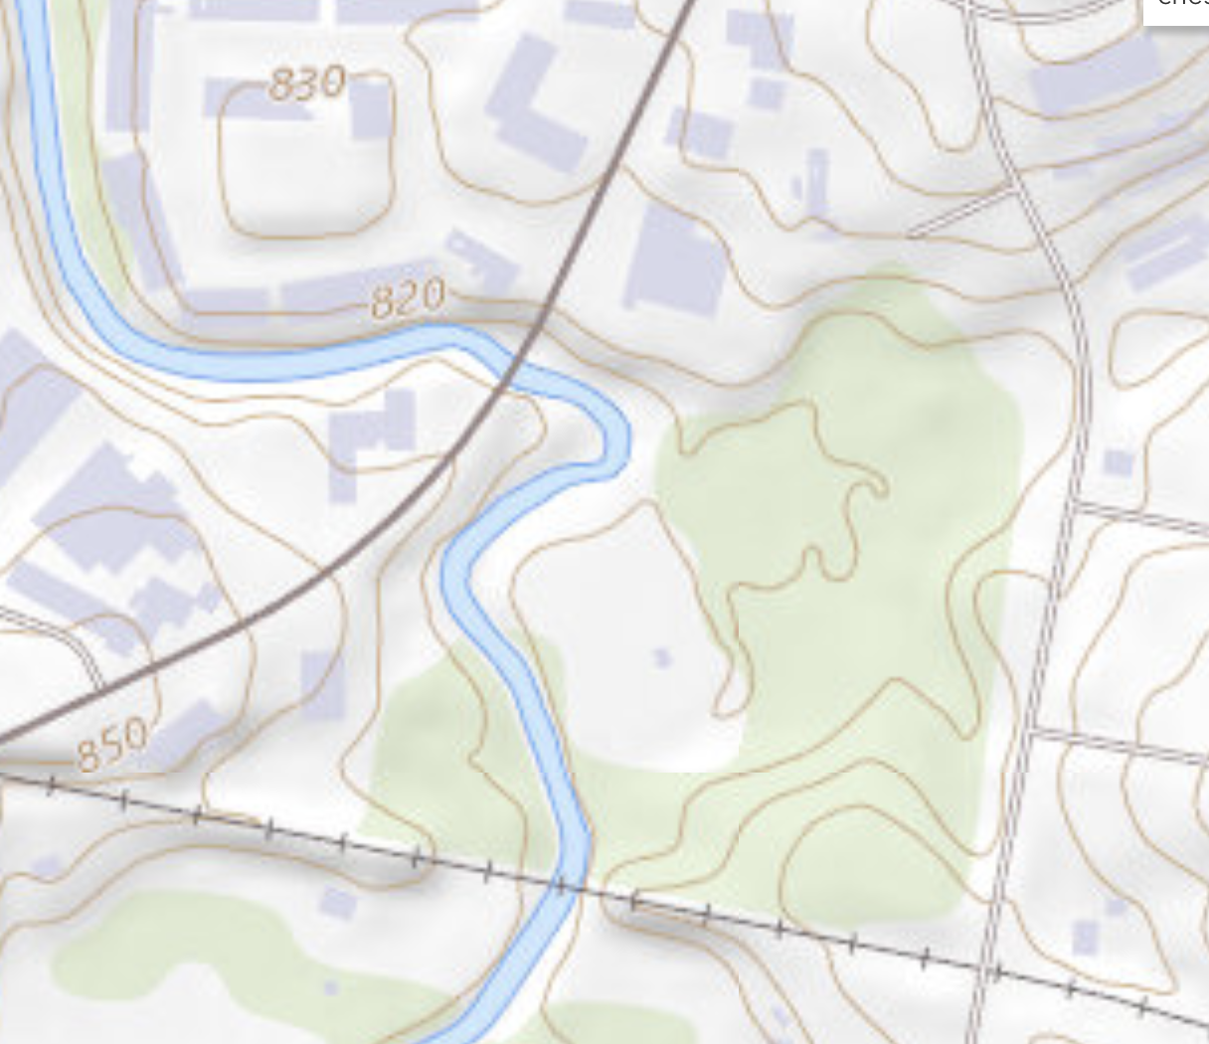
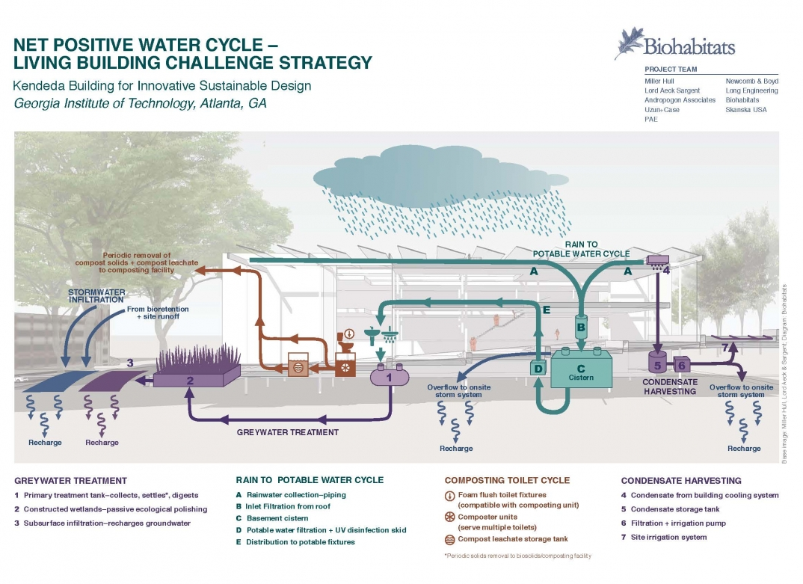
Water Design
Consumption
  Annual per capita potable water consumption - 82,900L
  Sewer assuming national average of 100L/day/person
Recycle
  Greywater - Irrigation
  Rooftop Rain Capture - Portable
Stormwater System
  discharge to the creek, no treatment needed
Notes:
Greywater refers to domestic wastewater which is produced from of laundry, shower, and hand basin water; after treatment, greywater from our residential buildings will be used to irrigate our community gardens.
Rainwater will be captured through gutters on the roof and stored in an underground cistern tank treated by filtration and UV disinfection process. The treated water then will be distributed as potable water.

Slide 10
Water
Annual per person
  Net Energy - 0.352MWh
  Net GHG Emission - 0.243 tCO2e
All calculations are conservative
  Use higher estimated value of consumption and lower for water recycle technology
Calculations are based on the whole community per year
  Water recycle technologies are per community
Comment on Technology
  Rain capture from rooftop is yield by net rooftop areas
  Greywater underground treatment also consumes energy (conservative calculations)

Slide 11
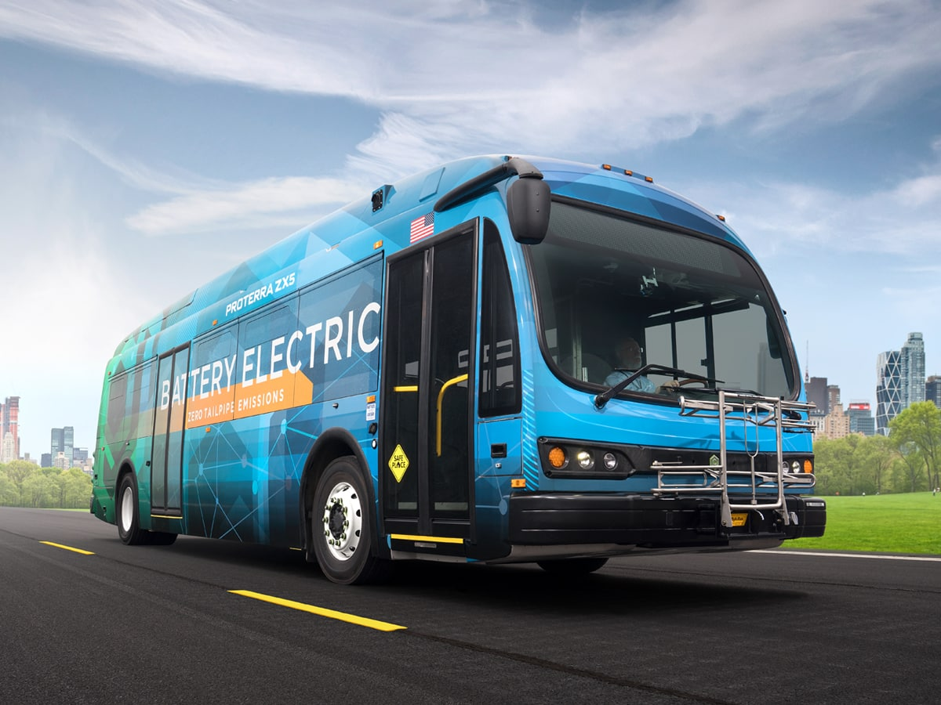
Transportation
Personal vehicle travel: People age 65+ make 2.75 trips per day
Transit: MARTA extension or electric bus
Additional modes
  Electric golf carts
  Mobility scooters
Parking: Accommodates all
Emissions estimated for each type of vehicle
Proterra ZX5
Notes:
Despite the age of our residents, a vast majority still drive. People 65+ make an average of 2.75 trips per day which contributes to a lot of emissions. In an effort to lower this and provide accessibility we are considering two different transit options. The first being an extension of the route 6 MARTA bus line that is just north of the neighborhood. This would give residents access to places like grocery stores, banks, and religious centers. The second option is an ADA accessible electric bus that solely services the residents. this would be more accessible and more efficient but would cost more. Additional travel modes within the neighborhood include electric golf carts and mobility scooters and the proposed parking has space for these. The emissions for all these modes were calculated and are shown later.

Slide 12
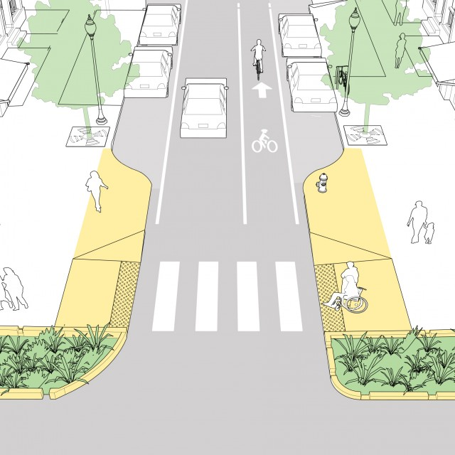
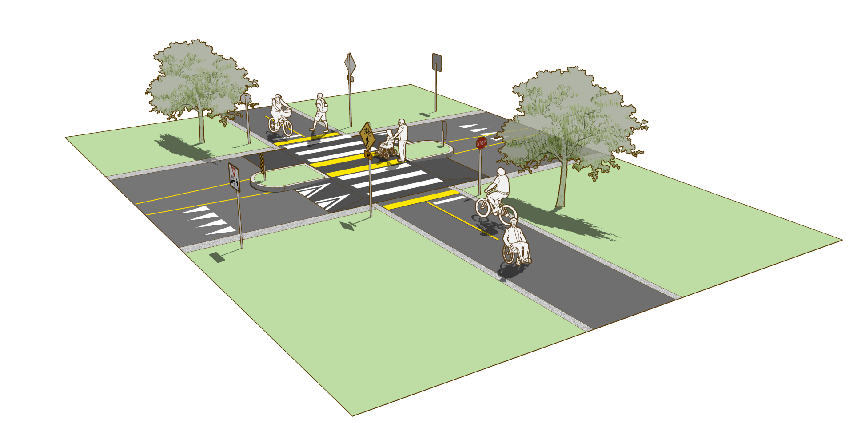
Accessibility and Transportation Design
18% of people age 65-69 experience a mobility issue
  Increases to about 40% for people age 80+
17% of people 70+ are not licensed to drive
Ease of activity through design
  Wide sidewalks
  Bike lanes lining the roads
  Multi Use path
  ADA design: ramps, curbs, tactile pads
  Audible crosswalks
  Abundant resting areas
NACTO design
Rural Design Guide: Multi Use path
Notes:
18% of people 65-69 experience a mobility issue and this percent continues to go up with age. Also 17% of people 70 and up are not licensed to drive. To improve the quality of life and encourage activity for these residents we will incorporate accessible design principles. These include wider sidewalks, bike lanes, a multi use path, ADA compliant ramps and curb cuts, audible crossings, and frequent resting spots like benches.

Slide 13
GHG Emissions
Type of Emissions | Annual GHG Emissions
Water | 0.5823
Transportation | 0.7812
Buildings | 39.9809
Savings | -3.9536
Total | 37.3908
*Emissions given in annual metric tons of CO2e per capita
Savings achieved through use of solar panels, water reuse processes, and conversion of kinetic energy
Notes:
Amelia

Slide 14
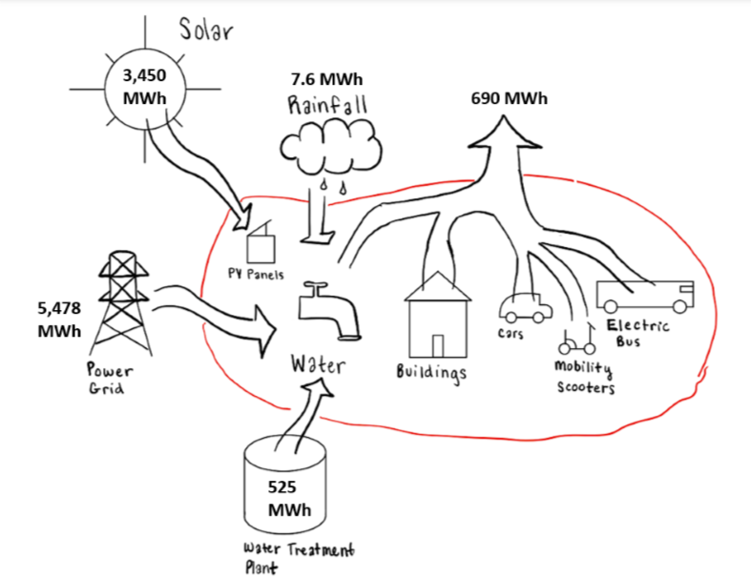
Urban Metabolism
Annual energy inflows and outflows associated with water, buildings, and transportation
infrastructure
Inflows
Power grid
Water treatment
Solar energy
Rainfall
Outflows
Wastewater
Transportation emissions
Building operations

Slide 15
Conclusions
Design Solutions
  24/7 medical center to provide immediate medical care
  Community center with social activities
  Recreational center with gym to promote healthy exercise
  Cafeteria with nutritious food options
  Accessible transportation options
  Green spaces promote better general health, increase life satisfaction, and lower stress
  Additional handicap parking spaces and ADA ramps and handrails
Sustainability
  Solar panels lower emissions by about 3.8 t CO2e
  Greywater system and rain barrels lower emissions by about 120 t CO2e
  Electric buses lower emissions
  Total CO2 emissions ~ 37.4 t CO2e per capita
Notes:
Hannah
In conclusion, these are some of our design solutions including providing access to medical care, a community center to prevent loneliness, a recreational center with a gym, a cafeteria with nutritious food options, access to transportation, green spaces like community gardens and a trail along the creek, and additional ADA accommodations.
We also aimed to make a sustainable design for this community by using solar panels, a greywater system, rain barrels, and electric buses to lower our overall emissions.

Slide 16
References
https://ruraldesignguide.com/physically-separated/shared-use-path
https://nacto.org/publication/urban-street-design-guide/street-design-elements/curb-extensions/gateway/
https://www.proterra.com/products/transit-buses/
https://livingbuilding.gatech.edu/water-petal
https://www.google.com/maps
Notes:
These are all of our references

Slide 17
Questions?
Notes:
And that’s the end of our presentation. Any questions?
Thank you!

