Slide 1
Highway Vehicle Classification for Maintenance
Group D
Christian Clowers, Saralina Reynoso, Tamon Uruno, Haolin Wang, Echo Zhu

Slide 2
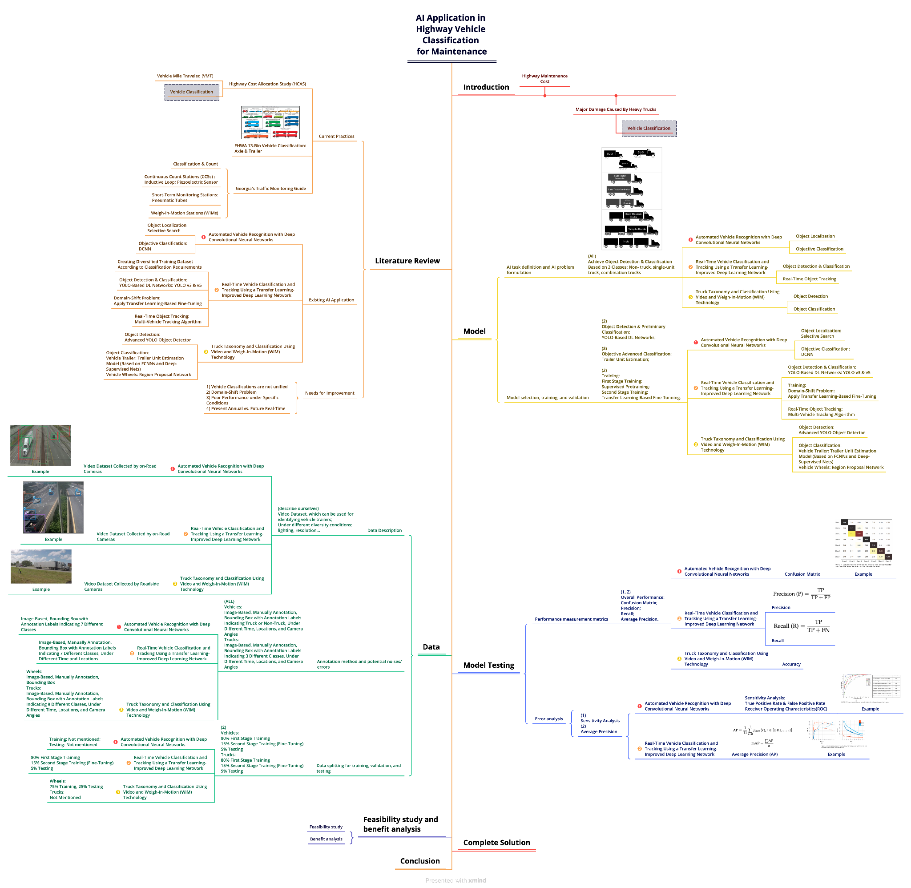
Presentation Overview
Introduction
Literature Review
Proposed Methodology – Model
Proposed Methodology – Data
Model Testing
Feasibility study & Benefit analysis
Complete Solution
Conclusion
References

Slide 3
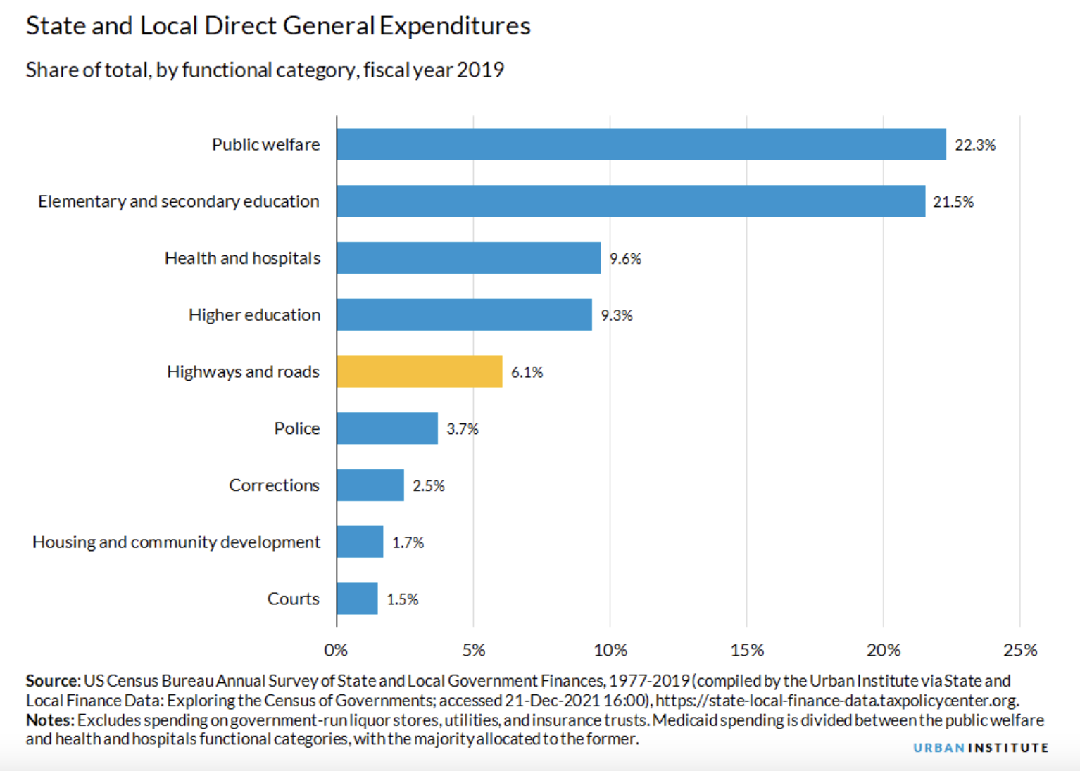
Introduction
Background
The annual cost for U.S. national highway road maintenance is estimated at more than 6 billion for the total 220,000 miles.
Highways: ~6% of state and local direct general expenditures
Routes with fewer lighter cars passing over them will significantly outlast a busier highway with more trucks passing by regularly.
Current method for vehicle classification is manual: Weigh In Motion (WIM)

Slide 4
Introduction
Objective
Need: AI classification for maintenance purposes using cameras on highways instead of Counts Stations and Weigh-In-Motion

Slide 5
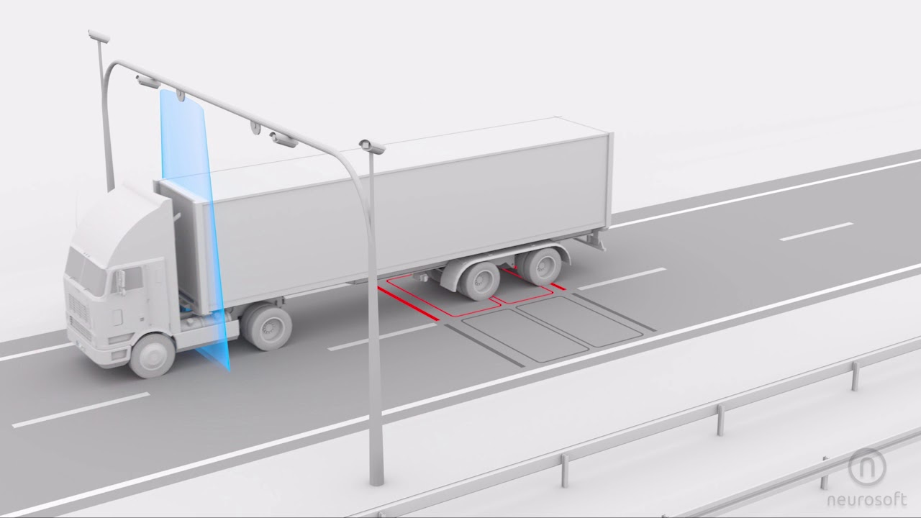
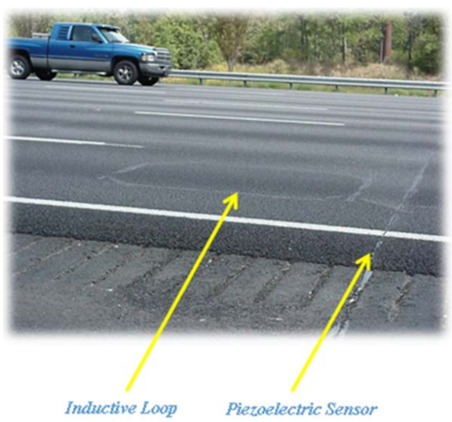
Literature Review
Current practice
  Counts Stations & Weigh-In-Motion
  FHWA’s 13 categories
Multiple Existing AI
  Object Detection & Object Classification
  Different Classification Categories for Different Purposes
No sufficient data for maintenance analysis needs
(14 permanent WIM in Georgia in 2018)
No unified vehicle classification category for maintenance needs
No mature methods for agencies to automatically collect volume and classification using video cameras
Weigh-In-Motion
Counts Station [3]

Slide 6
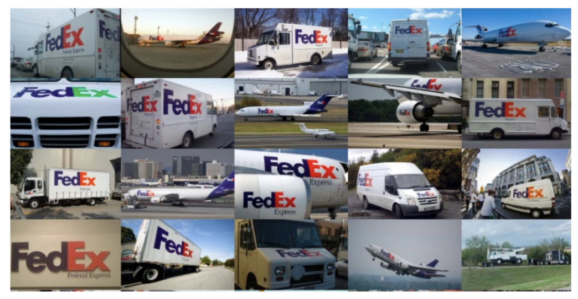
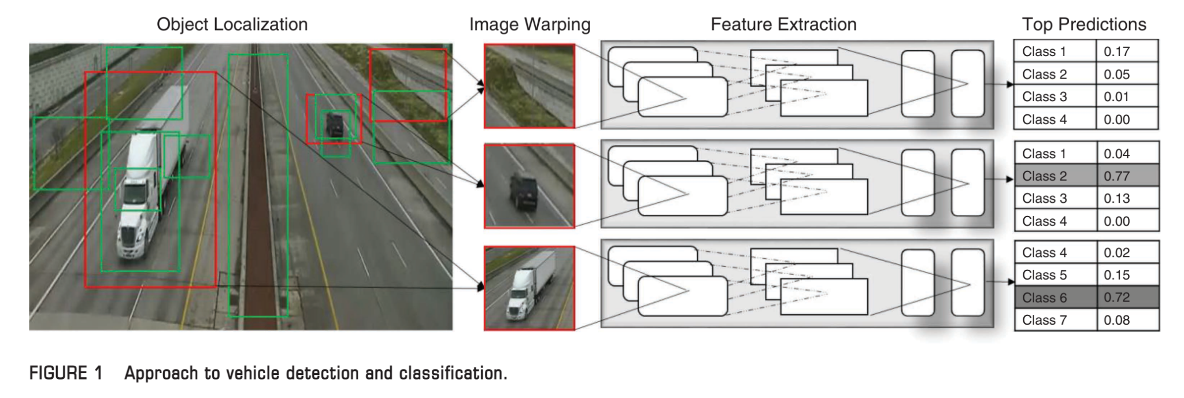
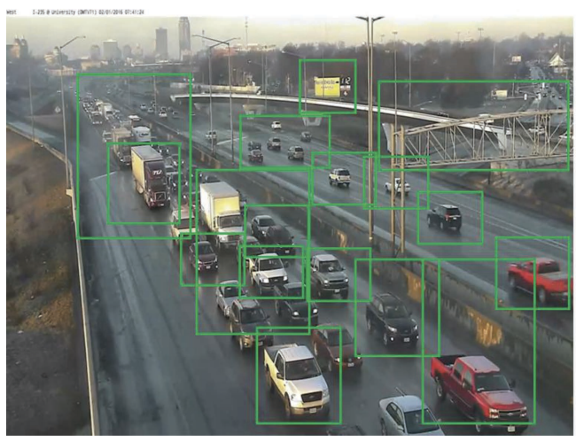
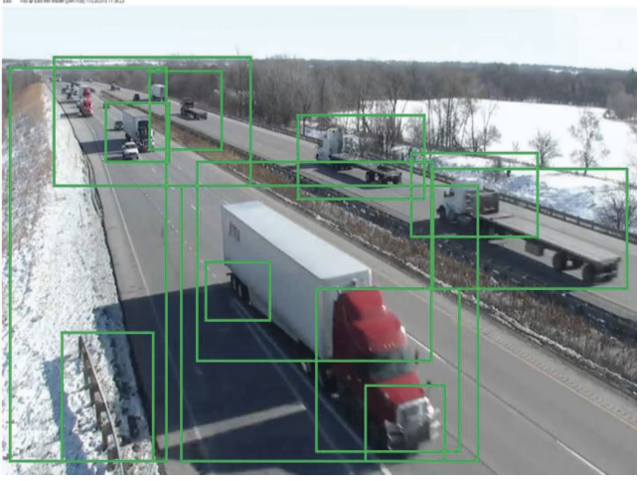
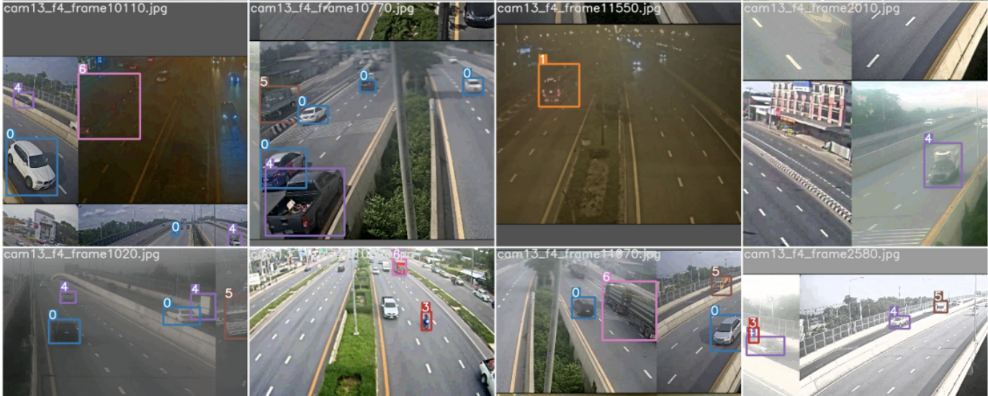
Proposed Methodology – Model
Model Selection, Training, and Validation
AI Task Definition
Notes:
The Models that we have chosen include YOLO (you only look once) and Deep Convolutional Neural Network (or DCNN)
First we define the AI Task which is to achieve Object Detection and classification based on three classes non-trucks, single unit trucks, and combination trucks.
For the Advanced Classifications:
Selective Search Object Localization and DCNN classification
YOLO v3 & v5 Object Detection and Classification
Multi-Vehicle Tracking Algorithm for Real-Time Object Tracking
Advanced YOLO Object Detection and Trailer Unit Estimation model
The trainings for our model includes:
First Stage Training
Supervised Pre Training (in which a very large training data set is needed to avoid overfitting the model)
Second Stage Training (which is Transfer Learning-Based Fine-Tuning)
Lastly, Domain-specific which means that in order to adapt the pretrained model to the proposed task (vehicle recognition), the CNN model parameters are fine-tuned

Slide 7
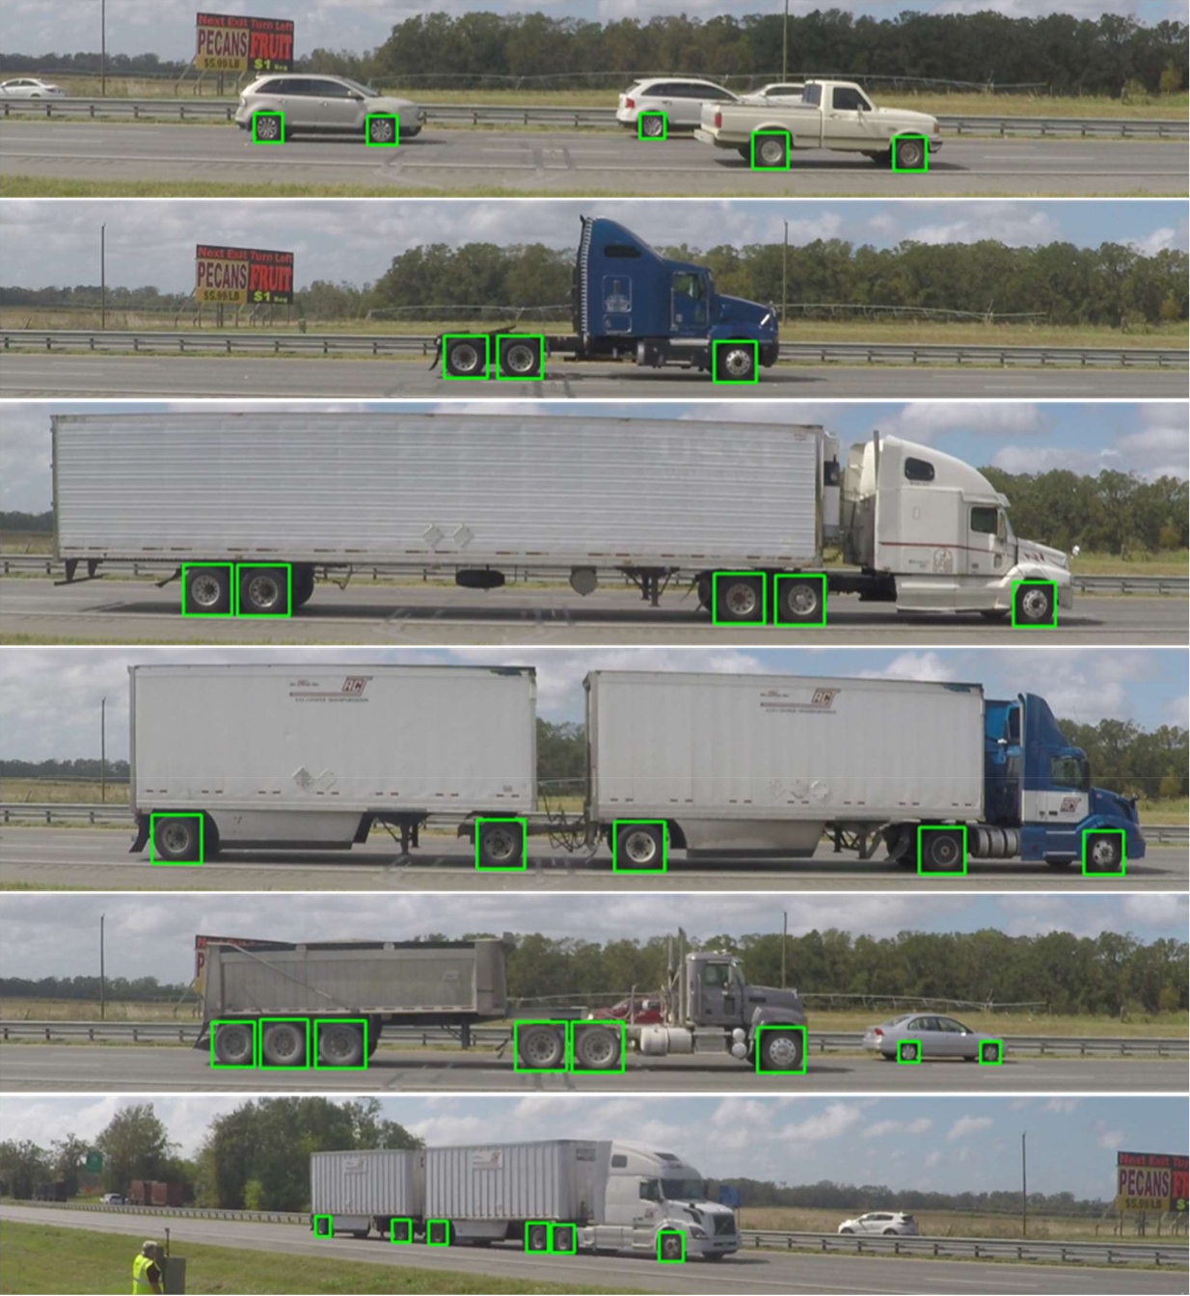
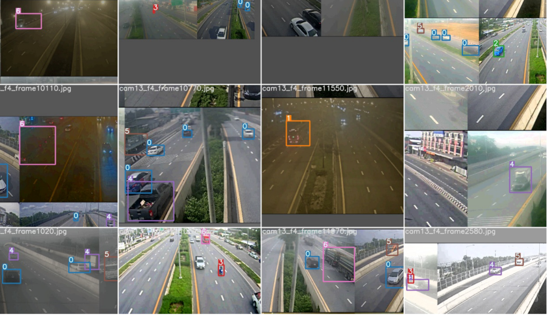
Proposed Methodology – Data
Video collected by On-road & Roadside Cameras
DIVERSITY IS THE KEY!
COMPLIANCE WITH CLASS CATEGORIES!
Notes:
Compliance with categories (note: if we want non-truck, single-unit truck, combination trucks, then we have to collect data considering all three categories’ diversity)

Slide 8
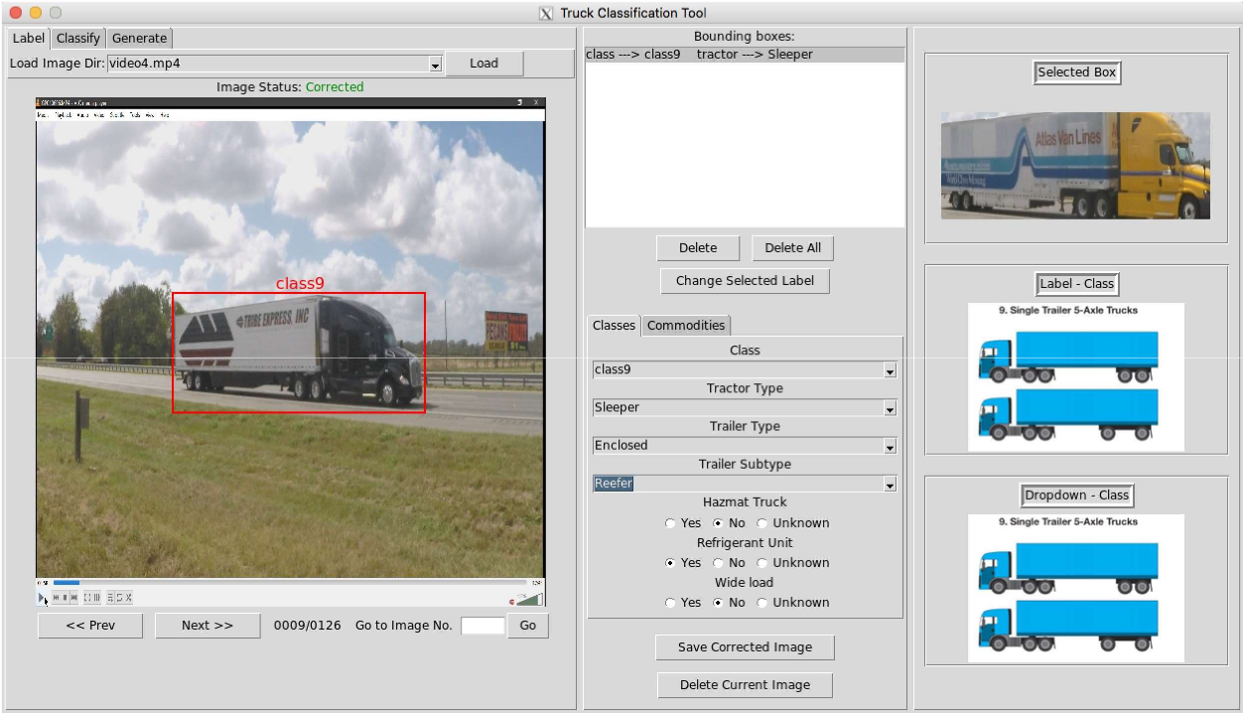
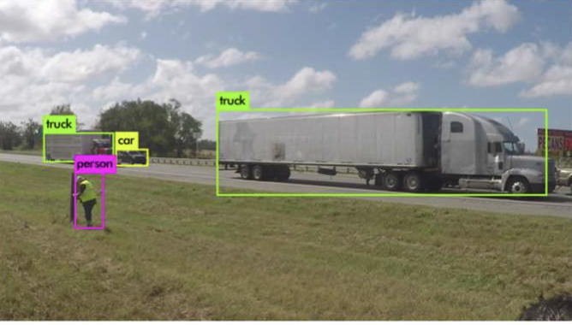
Proposed Methodology – Data
Annotation Methods
Manually Annotation
Bounding Box
Data Annotation Tool [4]
Notes:
The image panel (left) lets the users select a gallery of labeled images at the top and then move through the images using the bottom pane of the panel. The label panel (middle) allows the user to select and modify the current images labels. The example panel (right) shows the user the bounding box image separately to better see what was selected. The example panel also helps to define classes and provide visual guidance on labeling.

Slide 9
Proposed Methodology – Data
Data Division
iSome current practices for splitting data are:
Truck Taxonomy and Classification (He, 2019)
Shuffled
70% Training
30% Testing
Real-Time Vehicle Classification (Neupane,2022)
80% First Stage Training
15% Second Stage Training (Fine Tuning)
5% Testing

Slide 10
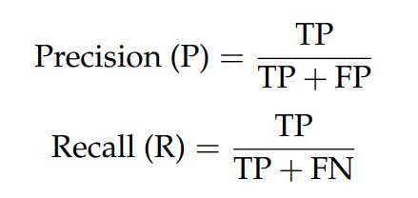
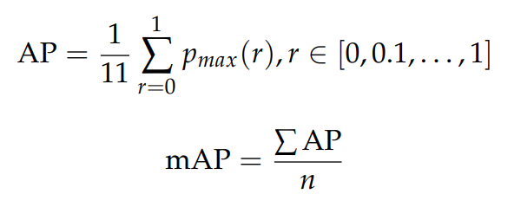
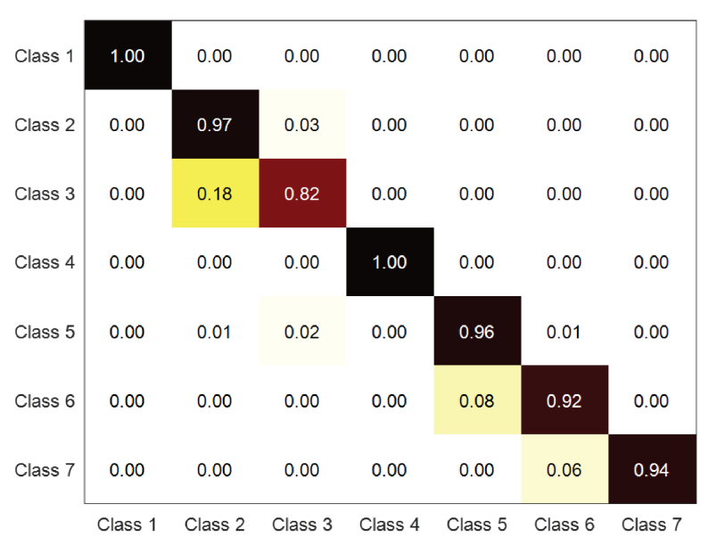
Model Testing
Performance Metrics
Precision and Recall
TP, FP, FN
  Detected and Correctly classified
  Detected but Incorrectly classified
  Not detected
Confusion Matrix
  Numbers closer to zero indicate the degree of inaccuracy
AP and mAP

Slide 11
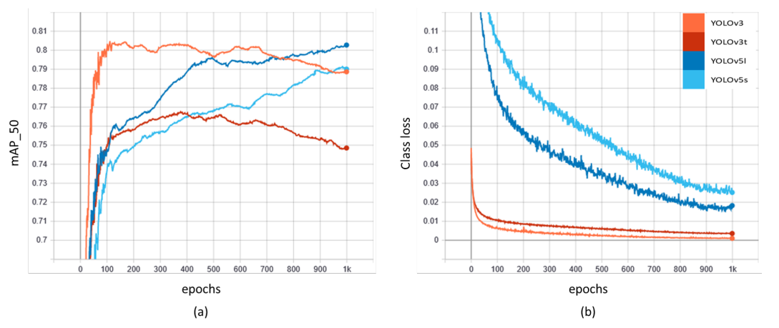
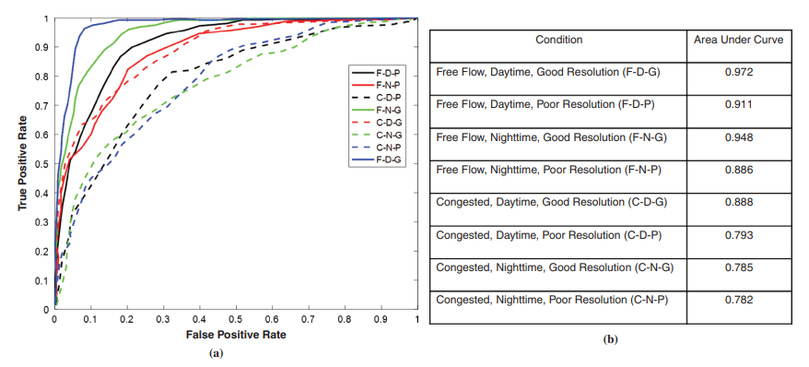
Model Testing
Error Analysis
Mean Average Precision
  Classification loss
  YOLO v5l & YOLOv3
    highest mAP_50
    lower classification loss
Sensitivity analysis
  Time of the day
  Traffic conditions
  Camera resolution
  Receiver Operating Characteristics (ROC) curves

Slide 12
Feasibility Study & Benefit Analysis
Feasibility Study
Existed: AI model, camera devices & diverse data collection and data storage
3 category
Limitation: ways to identify and count wheels of trucks, not only trailers
Follow-up trainings management needed, but easy to implement
Benefit Analysis
Maintenance!
Manual -> Auto: save time & labor
Save sensor device cost; no extra cost
More accurate than WIM, bigger data network; easier to validate using video-based
Cost:
labor follow-up training/management/
DATA management/storage;

Slide 13
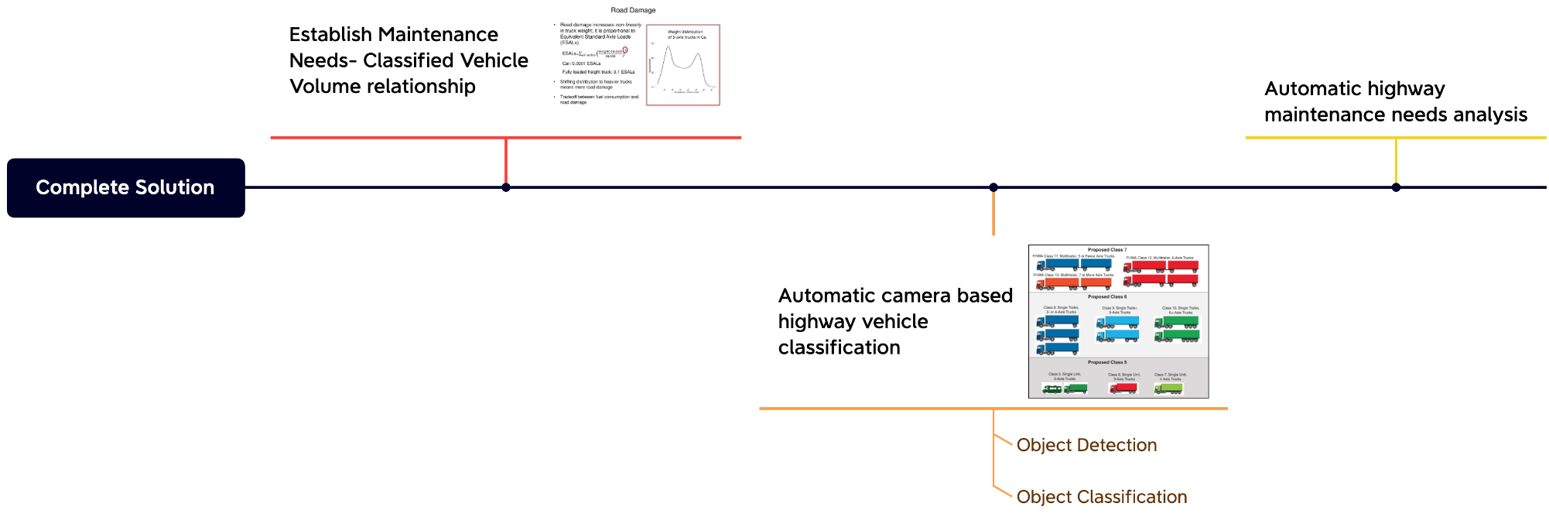
Complete Solution
Tasks Needed for AI Model Refinement and Implementation
  Training with more error cases (images with heavily occluded vehicles, low- resolution images, etc.)
  Diversify training dataset with real- time video stream
  Image post-processing techniques (noise filtering, night vision enhancement, etc.)
Components and their Relationship for Solving Real-world Problem
  Establish Maintenance Needs-Classified Vehicle Volume relationship
  Automatic camera-based highway vehicle classification
  Automatic highway maintenance needs analysis

Slide 14
Conclusion & Future Works
Future Works
Model: to improve accuracy during congestion/nighttime
Maintenance Purpose: to develop correlation between passing vehicles & damage; to establish method of road maintenance prediction on nearby roads
Follow ups: training & management
  Data
Labor
Potential data source for future other systems for detection/ AI application ie. license plate
Conclusion:
Methodology
  model, data, evaluation, feasibility
It is a Feasible Implementation
Limitation & Costs

Slide 15
References
Highway and Road Expenditures. (n.d.). Urban Institute. Retrieved October 26, 2022, from https://www.urban.org/policy-centers/cross-center-initiatives/state-and-local-finance-initiative/state-and-local-backgrounders/highway-and-road-expenditures
BuilderSpace. (2021, September 26). How Often Do Roads Need To Be Paved? BuilderSpace. https://www.builderspace.com/how-often-do-roads-need-to-be-paved
Georgia’s Traffic Monitoring Program. (n.d.). 37.
He, P., Wu, A., Rangarajan, A., & Ranka, S. (2019). Truck Taxonomy and Classification using Video and Weigh-In-Motion (WIM) Technology (dot:62977). https://rosap.ntl.bts.gov/view/dot/62977
Neupane, B., Horanont, T., & Aryal, J. (2022). Real-Time Vehicle Classification and Tracking Using a Transfer Learning-Improved Deep Learning Network. Sensors, 22(10), Article 10. https://doi.org/10.3390/s22103813
Adu-Gyamfi, Y. O., Asare, S. K., Sharma, A., & Titus, T. (2017). Automated Vehicle Recognition with Deep Convolutional Neural Networks. Transportation Research Record, 2645(1), 113–122. https://doi.org/10.3141/2645-13

